Slide 1

State Asset Policy – Building the Economic Security of Working Families
Opportunities for Working Families in
Tight Budget Times:
A Leadership Forum for State Legislators
National Conference of State Legislatures
June 25th, 2012
Presentation by Heather McCulloch
Principal/Asset Building Strategies
www.AssetBuildingStrategies.com

Slide 2
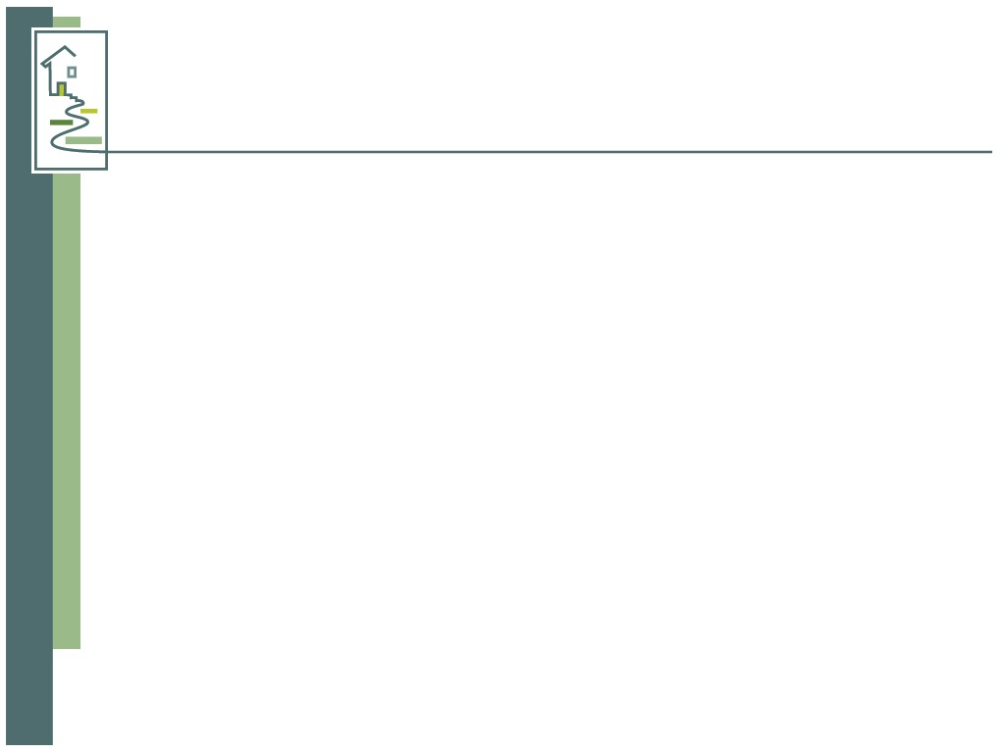
What are assets and why do they matter?
Financial assets – cash savings, stocks, bonds,
home, business and real estate equity
Income enables families to get by.
Assets enable them to:
  Weather financial crises
  Invest in their children and their communities
  Plan for a secure retirement
  Pass resources on to future generations

Slide 3
Challenge: Asset Poverty
27% - or 1 out of 4 - households is asset poor
  If you exclude illiquid assets, 43% are asset poor
2 of every 5 children lives in an asset-poor households including...
  1 of 2 Hispanic and African American children
  1 out of 4 White children

Slide 4
Economic Challenges
Wealth in America is heavily concentrated
  The wealthiest 20% of households own 85% of the nation’s wealth
  The bottom 80% of U.S. households hold only 15%
The recession has resulted in significant wealth loss among middle- class households
  From 2007-2010, the net worth of the median American household fell by almost 40% (Federal Reserve, June 2012)
  From 2005-2009, median wealth fell by 66% among Hispanic and 53% among African American households (Pew Research Center, July 2011)

Slide 5
Asset Building Policy
The field of asset building focuses on building pathways into the middle class
America has a long history of successful asset-building policies
Policy benefits are inaccessible to working families who:
  Can’t afford to buy a home
  Work in low-wage jobs without benefits
  Can’t access the full benefits of tax credits and deductions, unless they’re refundable
Asset policies benefit wealthier households:
  Top 20% receive 84% of benefits
  Bottom 60% receive less than 5% of benefits

Slide 6
Continuum of Asset-Building Opportunities
Working Families
Economic Security
Access to Mainstream Financial Services
Asset Preservation Measures
Savings Opportunities
Investment Opportunities
Financial Education

Slide 7
Common Goals
Products & Services
Savings
Investment
Preservation

Slide 8
Financial Education, Products and Services
Financial education – Expand access to financial education in schools, the workplace and communities
Financial services – Connect families to mainstream financial services
Develop new products and services that meet the needs of lower-income consumers

Slide 9
Savings
Savings at tax time
Asset limits
Earned Interest Tax Credit (EITC)
Savings for higher education
Individual Development Accounts (IDAs)
Matched savings accounts for children
Prize-linked savings accounts

Slide 10
Investment
Homeownership -
  Strategies that are safe and affordable
Business ownership
    Small business and microenterprise development
    Employee ownership

Slide 11
Preservation
Foreclosure prevention/mitigation
Fees and interest rates on payday and auto-title loans
Access to health, home and auto insurance

Slide 12
Why Now?
Working families need access to opportunities to help them weather the downturn and rebuild their financial security.
They need opportunities to access:
Financial education
Credit counseling
Bank accounts
Low-cost financial services
Safe and affordable loan products

Slide 13
State Asset Policy Resources
NCSL www.ncsl.org/workingfamilies
Center for Social Development www.csd.wustl.edu
CFED www.cfed.org
New America Foundation www.assets.newamerica.net
PolicyLink/Ford Foundation Clearinghouse (Forthcoming, Winter 2012)

Slide 14
State Asset Policy—Building the Economic Security of Working Families
National Conference of State Legislatures
June 25th, 2012
Presentation by Heather McCulloch
Principal/Asset Building Strategies
www.AssetBuildingStrategies.com

